Slide 1
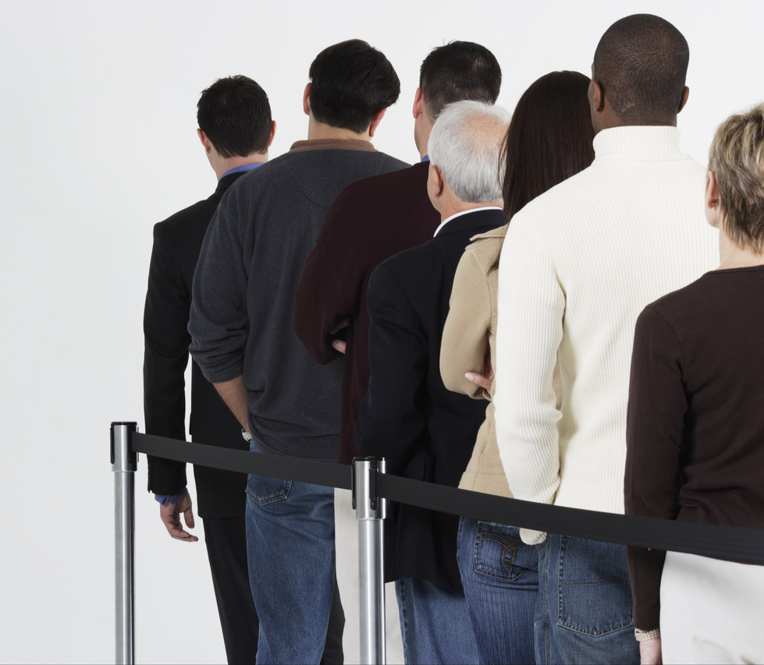
Health Portal
No more waiting…!
Team Novators:
Mian Zeshan Farooqi
Muhammad Mobeen Afzal

Slide 2
Health Portal
Patient suffering from disease has to wait in long queues and baring harsh attitude of staff…
Lower Satisfaction of Patient
Quarrel on receptions
Having all but nothing…!
Notes:
Waiting results from variations in arrival rates and service rates.
David H. Maister’s Laws of Service book
When customers expect a certain level of service, and then perceive the ser-vice they actually receive to be higher, then they will be satisfied. Conversely, when customers service expectations are higher than their perceptions once the service has been received, they are unsatisfied.
A common practice coming out of Law # 1 is to underpromise and over-deliver.
If customers start out happy when the service is first encountered, it is easy to keep them happy. If they start out disgruntled, it is almost impossible to turn things around.
Service Law # 2 is good for firms to remember when they are trying to im-prove service.

Slide 3



Issues to Consider
issues
Average time patient spent in queues
Condition of patient
Workload on hospital staff

Slide 4

Queuing Systems
queue
Queue: An ordered list of items, orders, or people waiting to be processed
Notes:
Made necessary by varying arrival rates and service requirements.
Properly thought out and designed queuing systems decrease waiting times and subsequently the need for further managing waiting times; however, occasionally, waiting time management tactics must be utilized to decrease perceived waiting times.

Slide 5
Queuing Systems
queue
Queue: An ordered list of items, orders, or people waiting to be processed
Notes:
Made necessary by varying arrival rates and service requirements.
Properly thought out and designed queuing systems decrease waiting times and subsequently the need for further managing waiting times; however, occasionally, waiting time management tactics must be utilized to decrease perceived waiting times.

Slide 6
Queuing Systems
queue
Queue: An ordered list of items, orders, or people waiting to be processed
Notes:
Made necessary by varying arrival rates and service requirements.
Properly thought out and designed queuing systems decrease waiting times and subsequently the need for further managing waiting times; however, occasionally, waiting time management tactics must be utilized to decrease perceived waiting times.

Slide 7
Queuing Systems
queue
Queue: An ordered list of items, orders, or people waiting to be processed
Notes:
Made necessary by varying arrival rates and service requirements.
Properly thought out and designed queuing systems decrease waiting times and subsequently the need for further managing waiting times; however, occasionally, waiting time management tactics must be utilized to decrease perceived waiting times.

Slide 8
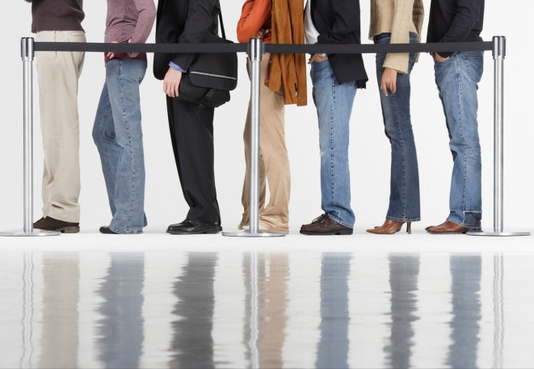
Health Portal
Sample Fill
Sample Fill
Sample Fill
Sample Fill
Get Rid of Token/Parchi System
Online appointments
Less wastage of time
Friendly environment for both staff and patient
Increased level of patient satisfaction
History Tracking
Better treatment
Notes:
Calling population – customers seeking to obtain a service / people in line for service
Arrival process – calculating the arrival time, and the interval between arrivals (Poisson distribution)
variation in demand intensity affects the requirements for service capacity
service capacity should be adjusted to meet demand when possible
this can be made possible through cross training employees or having the customers serve themselves (grocery store)
Queuing configuration – number of servers, their location, spatial requirements and their effects on customer behavior
virtual queue – no visual indication of your place in line
finite queue – not enough space to accommodate all customers
Service process – overall service performance
Most queuing models assume that customers stay in the line once they join it.
In other words, customers do not exhibit balking ( refusing to join the queue once they see how long it is) or reneging ( leaving the line before completing the service).
4/1/2012 9:51 AM
© 2007 Microsoft Corporation. All rights reserved. Microsoft, Windows, Windows Vista and other product names are or may be registered trademarks and/or trademarks in the U.S. and/or other countries.
The information herein is for informational purposes only and represents the current view of Microsoft Corporation as of the date of this presentation. Because Microsoft must respond to changing market conditions, it should not be interpreted to be a commitment on the part of Microsoft, and Microsoft cannot guarantee the accuracy of any information provided after the date of this presentation. MICROSOFT MAKES NO WARRANTIES, EXPRESS, IMPLIED OR STATUTORY, AS TO THE INFORMATION IN THIS PRESENTATION.
8

Slide 9

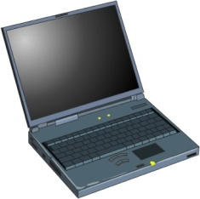
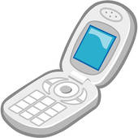
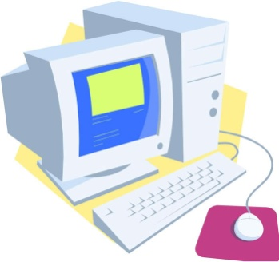
Health Portal
IIS
Web Services
Custom Apps
Mac Enabled Application
Desktop Apps
ASPX Pages
Mobile Apps
MySQL
SMS Apps
Http
Notes:
The choice of queuing system depends on:
the volume of customers to be served
the willingness of customers to wait in line
the physical constraints imposed by the service structure
the number and sequence of services to be performed
SS – single retailer
SN - dentist office
MS - McDonalds
MM – emergency room
When using queuing models, managers collect arrival rate and service rate data by observing, over time, how many customers actually arrive for service, and how many customers are served. Depending on the service, it may take a number of days or weeks to compile meaningful information.
4/1/2012 10:09 AM
© 2007 Microsoft Corporation. All rights reserved. Microsoft, Windows, Windows Vista and other product names are or may be registered trademarks and/or trademarks in the U.S. and/or other countries.
The information herein is for informational purposes only and represents the current view of Microsoft Corporation as of the date of this presentation. Because Microsoft must respond to changing market conditions, it should not be interpreted to be a commitment on the part of Microsoft, and Microsoft cannot guarantee the accuracy of any information provided after the date of this presentation. MICROSOFT MAKES NO WARRANTIES, EXPRESS, IMPLIED OR STATUTORY, AS TO THE INFORMATION IN THIS PRESENTATION.
9

Slide 10
Bonus
Sample Fill
Sample Fill
Sample Fill
Sample Fill
Business Intelligence/Data warehousing capabilities:
Adhoc Analysis
Process Improvement
Paper Reduction (environment friendly)
Notes:
Calling population – customers seeking to obtain a service / people in line for service
Arrival process – calculating the arrival time, and the interval between arrivals (Poisson distribution)
variation in demand intensity affects the requirements for service capacity
service capacity should be adjusted to meet demand when possible
this can be made possible through cross training employees or having the customers serve themselves (grocery store)
Queuing configuration – number of servers, their location, spatial requirements and their effects on customer behavior
virtual queue – no visual indication of your place in line
finite queue – not enough space to accommodate all customers
Service process – overall service performance
Most queuing models assume that customers stay in the line once they join it.
In other words, customers do not exhibit balking ( refusing to join the queue once they see how long it is) or reneging ( leaving the line before completing the service).
4/1/2012 10:02 AM
© 2007 Microsoft Corporation. All rights reserved. Microsoft, Windows, Windows Vista and other product names are or may be registered trademarks and/or trademarks in the U.S. and/or other countries.
The information herein is for informational purposes only and represents the current view of Microsoft Corporation as of the date of this presentation. Because Microsoft must respond to changing market conditions, it should not be interpreted to be a commitment on the part of Microsoft, and Microsoft cannot guarantee the accuracy of any information provided after the date of this presentation. MICROSOFT MAKES NO WARRANTIES, EXPRESS, IMPLIED OR STATUTORY, AS TO THE INFORMATION IN THIS PRESENTATION.
10

Slide 11
Types of Queuing Systems
Demand Source Server (s)
Single Channel Single Phase
Single Channel Multiple Phase
Multiple Channel Single Phase
Multiple Channel Multiple Phase
Notes:
The choice of queuing system depends on:
the volume of customers to be served
the willingness of customers to wait in line
the physical constraints imposed by the service structure
the number and sequence of services to be performed
SS – single retailer
SN - dentist office
MS - McDonalds
MM – emergency room
When using queuing models, managers collect arrival rate and service rate data by observing, over time, how many customers actually arrive for service, and how many customers are served. Depending on the service, it may take a number of days or weeks to compile meaningful information.
4/1/2012 10:02 AM
© 2007 Microsoft Corporation. All rights reserved. Microsoft, Windows, Windows Vista and other product names are or may be registered trademarks and/or trademarks in the U.S. and/or other countries.
The information herein is for informational purposes only and represents the current view of Microsoft Corporation as of the date of this presentation. Because Microsoft must respond to changing market conditions, it should not be interpreted to be a commitment on the part of Microsoft, and Microsoft cannot guarantee the accuracy of any information provided after the date of this presentation. MICROSOFT MAKES NO WARRANTIES, EXPRESS, IMPLIED OR STATUTORY, AS TO THE INFORMATION IN THIS PRESENTATION.
11

Slide 12
Perceived Waiting Times Management Techniques
Keep Customers Occupied
perception
Start the Service Quickly
Relieve Customer Anxiety
Keep Customers Informed
Group Customers Together
Design a Fair Waiting System
Notes:
Magazines, tv, toys for children
Give waiting customers menus, forms to complete, drinks
Ease anxieties
Observe customers and learn what is likely to cause anxiety for them.
Misery loves company, togetherness
First come, first serve / discipline

Slide 13

Managing Service Quality
Customer satisfaction with the service depends not only on the ability of the firm to deliver what customers want, but on the customers’ perceptions of the quality of the service received.
Service quality depends on the firm’s employees to satisfy customers varying expectations.
Notes:
4/1/2012 9:51 AM
© 2007 Microsoft Corporation. All rights reserved. Microsoft, Windows, Windows Vista and other product names are or may be registered trademarks and/or trademarks in the U.S. and/or other countries.
The information herein is for informational purposes only and represents the current view of Microsoft Corporation as of the date of this presentation. Because Microsoft must respond to changing market conditions, it should not be interpreted to be a commitment on the part of Microsoft, and Microsoft cannot guarantee the accuracy of any information provided after the date of this presentation. MICROSOFT MAKES NO WARRANTIES, EXPRESS, IMPLIED OR STATUTORY, AS TO THE INFORMATION IN THIS PRESENTATION.
13

Slide 14


Recovering Poor Service Quality
Keeps customers loyal and coming back and serves as good word-of-mouth advertising
To Recover From Poor Service
develop recovery procedures
train employees in these procedures
empower employees to remedy customer problems
Notes:
4/1/2012 9:51 AM
© 2007 Microsoft Corporation. All rights reserved. Microsoft, Windows, Windows Vista and other product names are or may be registered trademarks and/or trademarks in the U.S. and/or other countries.
The information herein is for informational purposes only and represents the current view of Microsoft Corporation as of the date of this presentation. Because Microsoft must respond to changing market conditions, it should not be interpreted to be a commitment on the part of Microsoft, and Microsoft cannot guarantee the accuracy of any information provided after the date of this presentation. MICROSOFT MAKES NO WARRANTIES, EXPRESS, IMPLIED OR STATUTORY, AS TO THE INFORMATION IN THIS PRESENTATION.
14

Slide 15
questions

Slide 16
Thank you!

